Slide 1

SGEMM GPU KERNEL PERFORMANCE
Predicting the running times for multiplying two 2048 x 2048 matrices using a GPU OpenCL SGEMM kernel with varying parameters
By Sanjana

Slide 2

Problem Description
This data set measures the running time of a matrix-matrix product A∗B=C , where all matrices have size 2048 x 2048, using a parameterizable SGEMM GPU kernel with 241600 possible parameter combinations. For each tested combination, 4 runs were performed and their results are reported as the 4 last columns. All times are measured in milliseconds*.
There are 14 parameter, the first 10 are ordinal and can only take up to 4 different powers of two values, and the 4 last variables are binary. Out of 1327104 total parameter combinations, only 241600 are feasible (due to various kernel constraints). This data set contains the results for all these feasible combinations.

Slide 3
Data Description
Attribute Information:
Independent variables:
MWG, NWG: per-matrix 2D tiling at workgroup level: {16, 32, 64, 128} (integer)
KWG: inner dimension of 2D tiling at workgroup level: {16, 32} (integer)
MDIMC, NDIMC: local workgroup size: {8, 16, 32} (integer)
MDIMA, NDIMB: local memory shape: {8, 16, 32} (integer)
KWI: kernel loop unrolling factor: {2, 8} (integer)
VWM, VWN: per-matrix vector widths for loading and storing: {1, 2, 4, 8} (integer)
STRM, STRN: enable stride for accessing off-chip memory within a single thread: {0, 1} (categorical)
SA, SB: per-matrix manual caching of the 2D workgroup tile: {0, 1} (categorical)
Output:
Run1, Run2, Run3, Run4: performance times in milliseconds for 4 independent runs using the same parameters. They range between 13.25 and 3397.08.

Slide 4
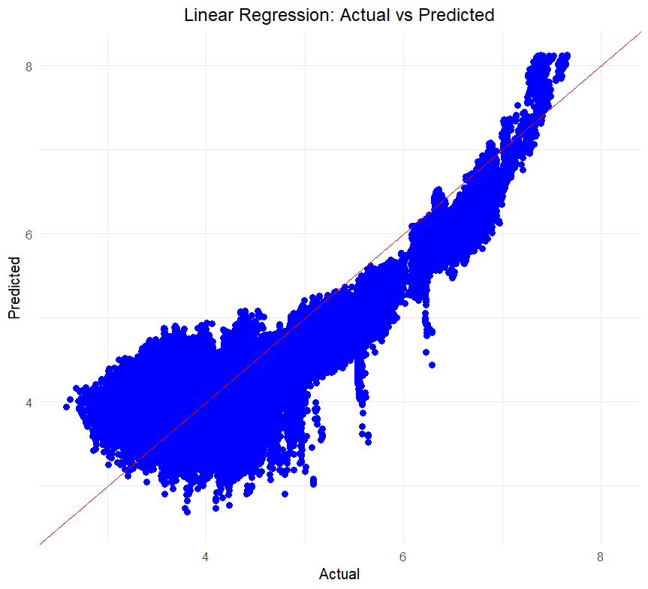
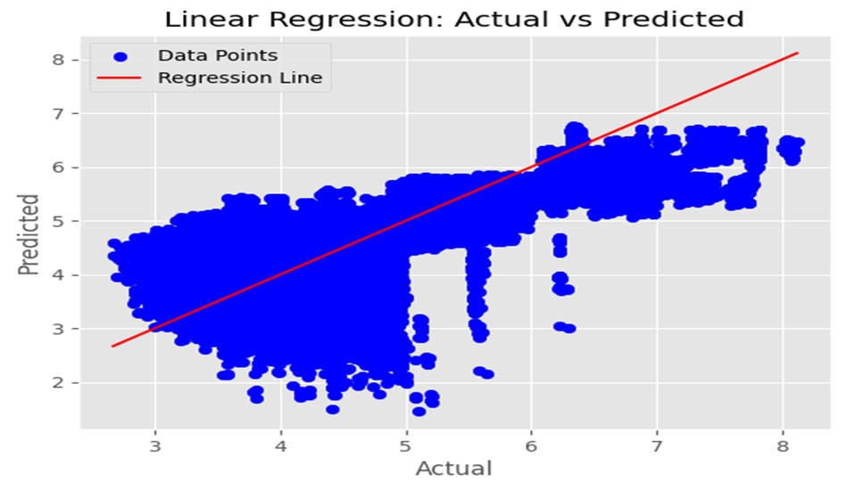
Python
R Programming

Slide 5
MSE = 0.294735591954632
MAE = 0.452727555479866
RMSE = 0.542895562658815
R-square value = 0.555023334728897
Adjusted R-square = 0.5549201688215724

